Slide 1
Christianity and Psychology: Mental Health Topics for Biblical Counselors
Andrew G. Kenagy, Psy.D.

Slide 2
Who am I?
Evangelical, reformed Christian
Clinical Psychologist

Slide 3
How I got here
Missions
Youth ministry

Slide 4
What I do
Psychotherapy, assessment
Specialize in children/adolescents, depression, anxiety, ADHD, psychological assessment, faith-integrated therapy

Slide 5
INTEGRATION OF PSYCHOLOGY AND CHRISTIANITY
4 Waves
  Apologetics
  Models
  Research
  Embodiment

Slide 6
Psychology is part of EVERYTHING
The moment you or a pastor says anything other than directly quoting the Bible, you’re engaging in psychology.
Even our English translations of the biblical text involve psychosocial processes.

Slide 7
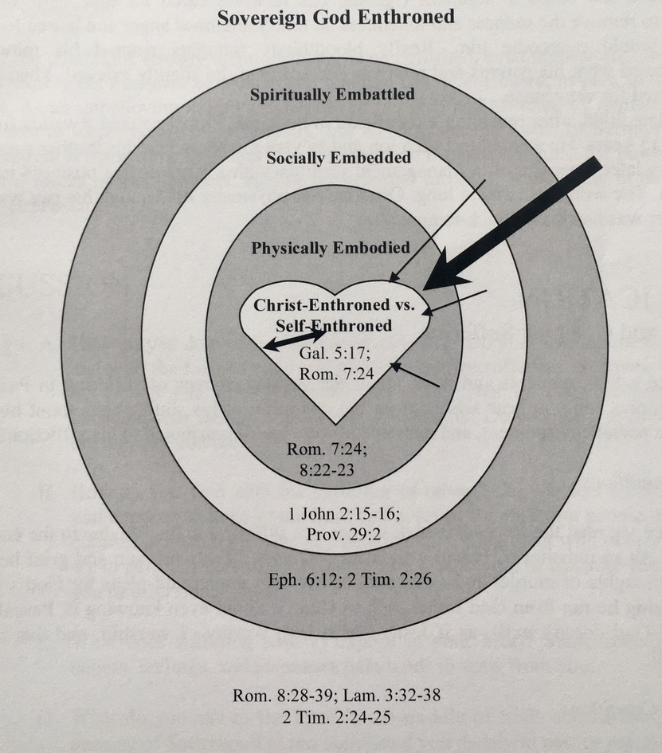
Biblical Counseling Model of Human Experience

Slide 8
Psychology: Not just about the brain, but the MIND
Not just a “physically embodied” phenomenon
Psychology: the science of mind and behavior
      Encompasses far more than just counseling, and informs counseling with deep, tested realities
      Christians who have despised psychology use psychology in their very art of making an argument and engaging in persuasion
      Why be warry of being extremely thoughtful, on the basis of rich scientific research, to inform how you understand and interact with clients?
        Instead, be warry of haphazardly interacting with people on the basis of purely anecdotal evidence and likely overly simplistic, reductionistic explanations.
          This demeans the glory of God manifest in the rich and complex depths of people made in his image
          All truth is God’s truth

Slide 9
Scripture on Mind being more than Matter
Hebrew word for “heart” = center of mind, will, and emotions
Pastor: “psychologists deal with the head; I deal with heart”
Protestant ideal of “Fact, Faith, Feeling” or “Put feelings in the caboose”
  What we determine to believe as “facts” can be based on some combination of thoughts and emotions. Why should one be lifted up as higher than the other?
    Our thoughts are just as deceptive, if not more, than our emotions
  https://www.desiringgod.org/articles/fact-faith-feeling

Slide 10
Scripture on Mind being more than Matter
“The Lord saw how great the wickedness of the human race had become on the earth, and that every inclination of the thoughts of the human heart was only evil all the time” (Genesis 6:5, NIV)
“Love the Lord your God with all your heart and with all your soul and with all your strength and with all your mind” (Luke 10:27, NIV)

Slide 11
Science on Mind being more than Matter
Consciousness
Temperament
Personality
Attachment
Interpersonal dynamics
Thinking patterns
Attribution styles
Defense mechanisms
Psychiatric medications
Nature vs Nurture

Slide 12
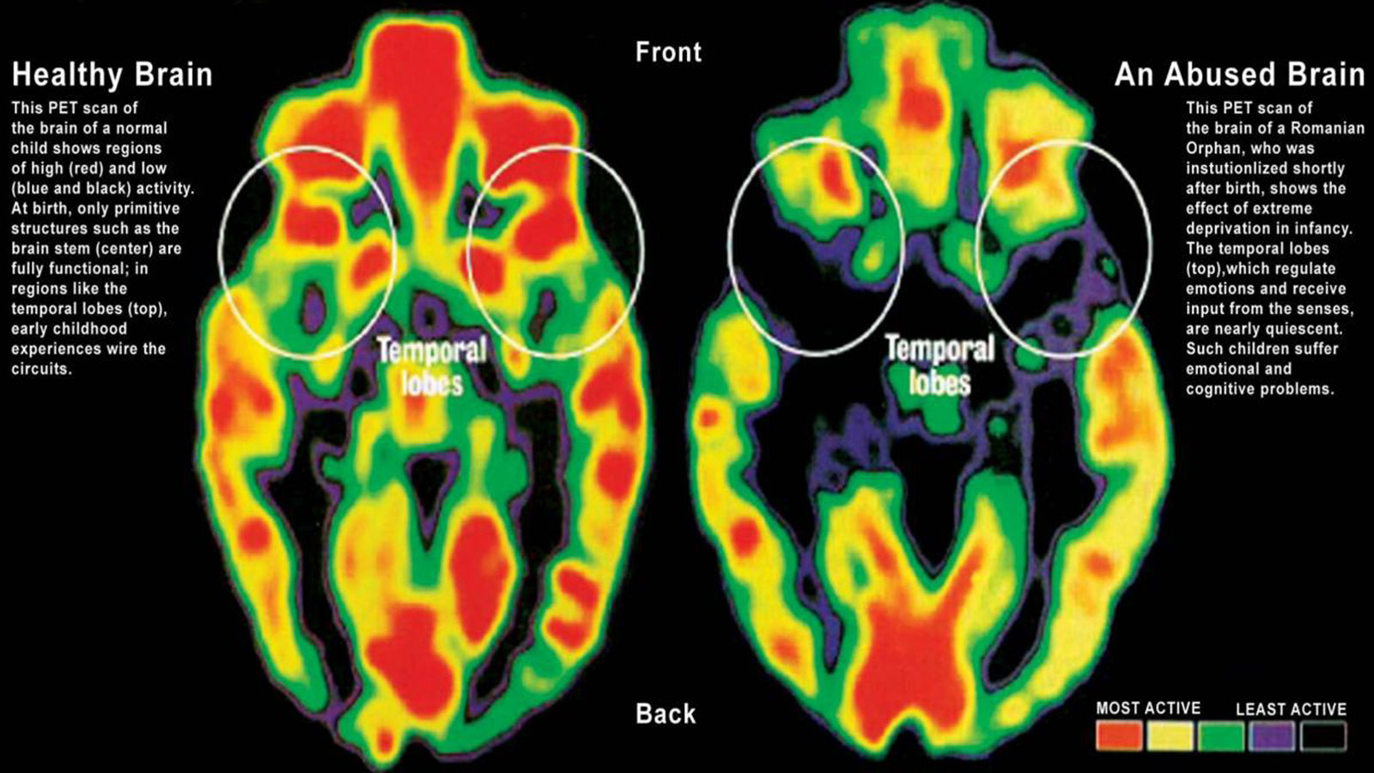
Interaction of neurobiology, mind, and environment
Neglect and trauma
Epigenetic mechanisms leading to intergenerational transmission of psychopathology (DNA function/gene transcription)
Neurotransmitters
  Which came first: depression or low serotonin?

Slide 13
Why give someone a Band-Aid when you can give them Jesus?
Is this what you say when someone comes to make a withdrawal from the bank, or to order food from a restaurant, or to have their swollen appendix removed at the hospital?
Complementary
  Does God have to categorize our experiences as spiritual, physical, mental, psychological, etc…?
Gain psychological resources for engaging with spiritual realities
  Where would you begin with training a 700-pound person to play basketball?
Bring the gospel to non-believers
  “I have become all things to all people so that by all possible means I might save some” (1 Corinthians 9:22b)
Helps me stop trying to be God and trust in His sovereignty

Slide 14
Why give someone a Band-Aid when you can give them Jesus?
Psychological privilege
  If you grew up with few family or personal challenges, it is easy to not grasp the depth and pervasiveness of how negative relational dynamics and experiences can affect someone for a lifetime in many complex ways
  Example: Results of insecure attachment due to a poorly attuned primary caregiver struggling with anxiety and depression, is often unpredictably responsive to an infant’s needs, and who themselves respond to many daily events with extreme emotional outbursts (e.g., panic)
    A pervasive sense (of mind and neurobiology) that the world is unsafe and unpredictable (frequent hyperactivation of sympathetic nervous system), leading to misinterpreting everything as a threat
    Poor sense of internalized security, confidence, or worth that empowers the cognitive capacities and psychological strength of will to even process life events in any other way or to emotionally and/or intellectually conceptualize (much less implement) skills to de-escalate emotions, self-soothe, take another perspective, or plan and organize a non-chaotic approach to life
  How dare we say someone in this position “just” needs more faith, prayer, etc… God made us as bio-psycho-social-spiritual beings; our psycho-spiritual privilege sometimes blocks well-meaning believers from seeing what this really means

Slide 15


Models

Slide 16
Introduction to Psychopathology for Biblical Counselors: Considering when to Refer

Slide 17
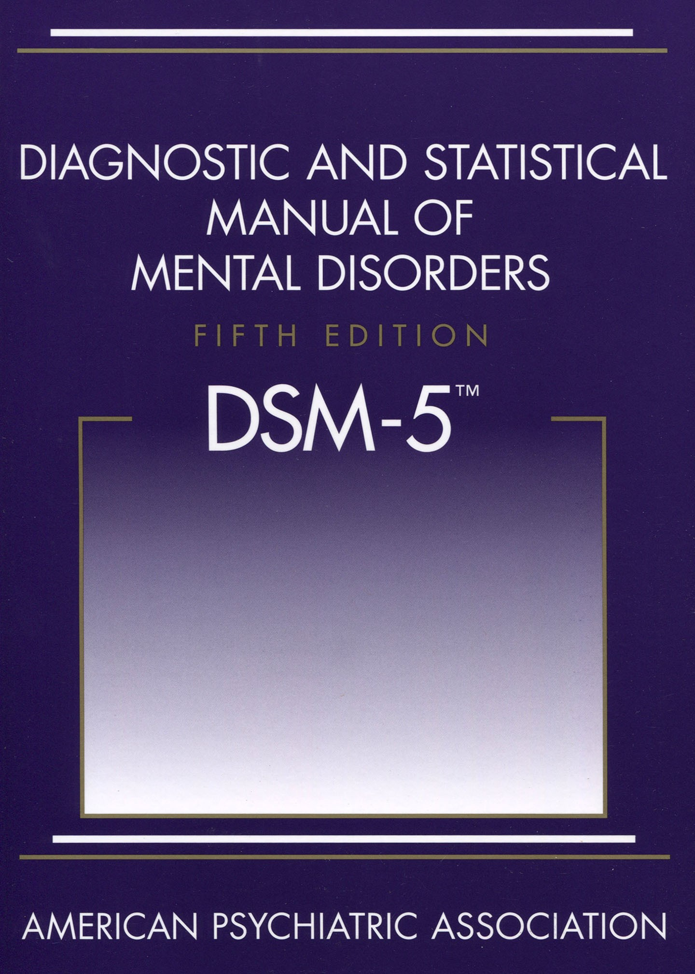
Medical model
Diagnoses are labels for a set of symptoms
  A diagnosis doesn’t mean you “have” something; it means you’re experiencing a set of symptoms for many possible reasons
  The way a diagnosis is expressed can vary widely (only need to meet a certain number of symptoms)
    E.g., ADHD, depression
Functional Impairment (socially, academically, vocationally) or “clinically significant distress”
Significantly influenced by politics and economics

Slide 18
Depression (15 types)
Symptoms
  Depressed mood most of the time (irritable mood in children/adolescents)
  Anhedonia
  Fatigue
  Sleep difficulties
  Decreased or increased appetite or weight
  Diminished concentration
  Psychomotor retardation or hyperactivity
  Feelings of worthlessness or excessive guilt
  Suicidal ideation

Slide 19
Depression
Possible reasons for referral
  Major functional impairment
  Treatment resistant
  Suicidal ideation with plans and intent, and/or significant prior history of attempts
  Profound history of trauma
  No identifiable situational factors

Slide 20
Anxiety
Symptoms
  Anxious or worried thoughts most of the time
  Difficulty controlling those thoughts
  Feeling restless, keyed up or on-edge
  Sleep difficulties
  Being easily fatigued
  Diminished concentration
  Muscle tension
  Irritability

Slide 21
Anxiety
Possible reasons for referral
  Major functional impairment
  Treatment resistant
  No identifiable situational factors

Slide 22
Post-Traumatic Stress Disorder (PTSD)
Symptoms
  Exposure to actual or threatened death, serious injury, or sexual violence
  Intrusive symptoms (e.g., nightmares, flashbacks, memories)
  Avoidance
  Negative alterations in mood or cognition
  Marked alterations in arousal or reactivity

Slide 23
Post-Traumatic Stress Disorder (PTSD)
Possible reasons for referral
  Major functional impairment
  Treatment resistant
  Suicidal ideation with plans and intent, and/or significant prior history of attempts

Slide 24
Attention-Deficit/Hyperactivity Disorder (ADHD)
Symptoms
  Inattention
    Details, careless mistakes, listening, follow-through, organizing tasks, resists mental effort, loses things, easily distracted, forgetful
  Hyperactivity
    Fidgets, squirms, leaves seat, runs/climbs, internal motor, talks excessively, blurts out answers, interrupts, waiting turn

Slide 25
Attention-Deficit/Hyperactivity Disorder (ADHD)
Executive function deficits
  Many possible reasons for this (including depression and anxiety)
  Prefrontal cortex hypoactivation
    Most medications for ADHD are stimulants to activate prefrontal cortex
    Debate on use of stimulants
  Behavioral treatment
    Compensatory strategies for executive function deficits

Slide 26
Attention-Deficit/Hyperactivity Disorder (ADHD)
Possible reasons for referral
  Major functional impairment for the individual or the individual’s family/spouse
    Emotional dysregulation common
  Children not responding to treatment
    Watch for the “exhausted parent”

Slide 27
Personality Disorders
Paranoid, schizoid, schizotypal, antisocial, borderline, histrionic, narcissistic, avoidant, dependent, obsessive-compulsive
Pervasive ways of being, especially in relationships
Deeply fractured sense of self
Often avoided by therapists

Slide 28
Personality Disorders
Signs to watch for:
  Extremely turbulent and unstable relational history
  Poor and unstable employment history
  Substance abuse
  Legal history
  Sudden, inexplicable changes in how they relate to you as their counselor (idealization/devaluation)
Refer

Slide 29
General Treatment Emphases
Healthy Lifestyle Behaviors
  Water, diet, exercise, sleep
Common Factors in Therapy
  Therapeutic relationship

Slide 30
Psychological Theories of Personality
Informative, but can leave the realm of science and become a philosophy or worldview
Many approaches influenced by humanism
  Founded on belief in human goodness
  Psychopathology seen as a consequence of mistreatment, not inherent self-centeredness
  Merely supporting and encouraging wounded people seen as sufficient to help them thrive

Slide 31
Psychological Theories of Personality
Why does a humanistic approach seem to help many people recover from the depths of mental illness?
  Satan does not have power to create, only to corrupt
  Perhaps treating people well awakens their God-consciousness - their sense that despite all their woundedness, there is still good in the universe (the image of God in them, and the reality of God surrounding them)
  Embodied (or incarnational) integration
    “And the Word became flesh and dwelt among us, and we have seen his glory, glory as of the only Son from the Father, full of grace and truth” (John 1:14 ESV).

Slide 32
Spiritually Integrative Interventions
Mindful prayer
  C.S. Lewis in The Screwtape Letters
    “The Present is the point at which time touches eternity. Of the present moment, and of it only, humans have an experience analogous to the experience which [God] has of reality as a whole; in it alone freedom and actuality are offered them.”

Slide 33
Spiritually Integrative Interventions
The “self-esteem” trap
  Pride can be manifest equally as thinking too highly of oneself (arrogance), or too low of oneself (false humility). Both focus on comparison to others, with the former being a display of our perception of greatness, and the latter being a protest against the lack of recognition of our greatness. Both make a god out of ourselves.
  “The essence of gospel-humility is not thinking more of myself or thinking less of myself, it is thinking of myself less” (Timothy Keller, in The Freedom of Self-Forgetfulness)
  The purpose of life if not to be made much of, but to make much of God (John Piper)
  Actions of love

Slide 34
Spiritually Integrative Interventions
Existential issues
  “I would be depressed too if I was just a cosmic accident”
  Call out the shallowness of basing self-worth on things like personal-performance, career, and even many aspects of relationships
  Point out the role of faith in clients’ lives (e.g., faith in evolution, faith in their own perceptions)
  To nominal Christians or the ‘spiritual but not religious:’
    “If any of this God-stuff is true, it changes EVERYTHING!”
    “Aren’t you alarmed at your lack of feeling or concern about something so MASSIVE?”

Slide 35
Spiritually Integrative Interventions
Existential issues
  Guilt and shame: forgiveness doesn’t satisfy without justice
    Christianity is the only reality that actually provides a resolution
    Don’t rescue clients from their discomfort; the most helpful thing you can do for them may be to make them uncomfortable with the holes in their worldview

Slide 36
Spiritually Integrative Interventions
Make use of grief
  Recognize and grieve unmet needs
  Grief leads to acceptance, which empowers exploration

Slide 37
Christianity and Psychology: Mental Health Topics for Biblical Counselors
Andrew G. Kenagy, Psy.D.
  www.drkenagy.com
  andrew@drkenagy.com
  Mid Valley Counseling Center
  www.mvcounseling.com

